Slide 1

ANALYTICAL STUDY OF
DURGA MEDICAL HALL
BUSINESS DATA MANAGEMENT
CAPSTONE PROJECT
Name: SHRUTI KUMARI
ROLL NO : 22F3001953
EMAIL : 22f3001953@ds.study.iitm.in

Slide 2
Problem statement
Capital blockage resulting from unrelated inventory hinders financial liquidity and operational efficiency, necessitating the adoption of just-in-time inventory management, diversification strategies, and rigorous inventory audits.
Demand forecasting challenges hinder optimal inventory levels, prompting the implementation of advanced planning techniques to align inventory with actual customer demand, thus enhancing operational efficiency and profitability.
Background of the problem:
The medical shop's past success has been overshadowed by online marketing proliferation, mall openings, and heightened local competition, resulting in revenue decline. Regulatory compliance, medication authenticity, and storage integrity pose persistent challenges, necessitating stringent adherence and proactive management. Supply chain disruptions compound operational hurdles, emphasizing the need for agile contingency planning. To address these issues, a strategic business approach prioritizing adaptability, compliance, and operational efficiency is imperative.

Slide 3
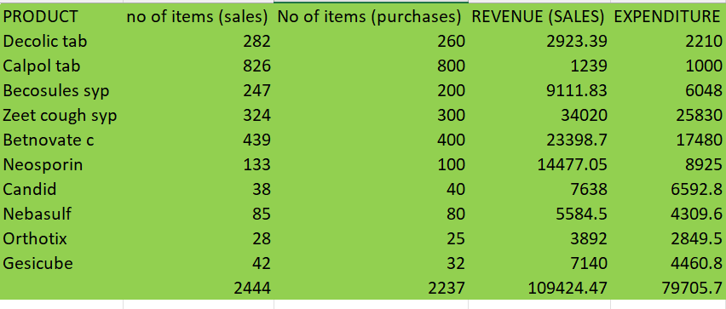
Data Analysis
1.Sales and Expenditure
The initial phase involved the creation of a sales
dataset featuring 10 distinct product categories,
including Decolic, Calpol, Becosules Syrup, Zeet
Cough Syrup, Betnovate C, Neosporin, Candid,
Nebasulf, Orthotix, and Gesicube. Each product is
accompanied by its respective selling price column.
Similarly, a Purchases dataset was established,
detailing purchase quantities and prices.
This meticulous analysis offers invaluable insights into
the financial performance of the product portfolio,
facilitating informed strategic decision-making processes.

Slide 4
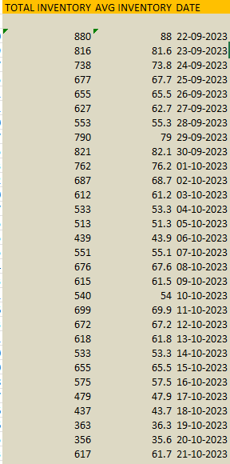
Data Analysis
2.Optimizing inventory
This comprehensive inventory management approach not only addresses
surplus stock accumulation but also furnishes strategic insights. By comprehending
inventory dynamics, the business owner can make informed decisions regarding
procurement, sales strategies, and inventory optimization, bolstering the shop's
resilience and adaptability amidst economic challenges. Ultimately, this can
enhance profitability and ensure business sustainability.

Slide 5
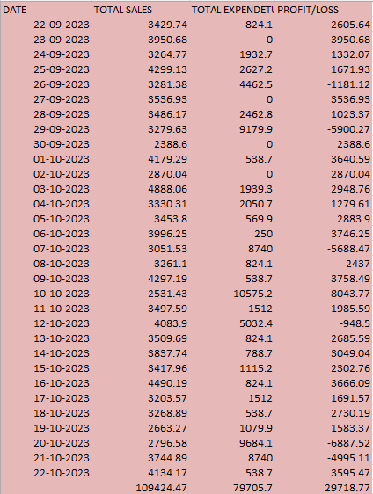
Data Analysis
3.2 Increase the overall profit of the business
The evolving retail landscape, marked by online platforms, malls,
and new outlets, poses significant profitability challenges for the
shop.
To navigate this complexity, a thorough financial analysis is
imperative. Initially, daily and SKU-specific profit or loss calculations
are conducted using sales and purchases data.
This analytical framework provides a robust foundation for strategic
decision-making, enhancing shop resilience and competitiveness
amidst evolving market dynamics.

Slide 6
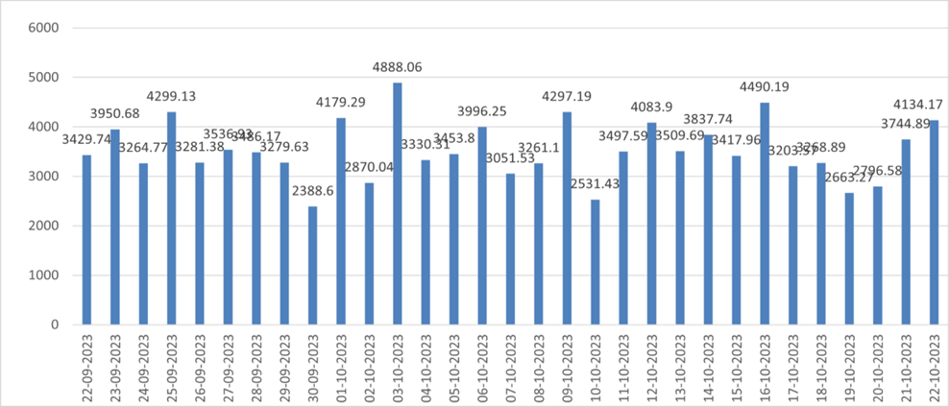
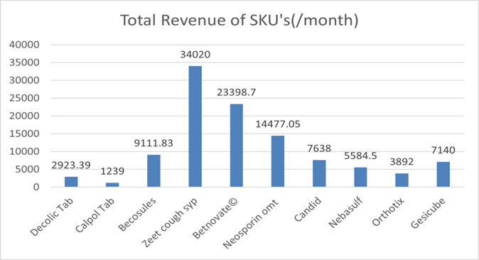
RESULTS
Volume Analysis (Sales, Purchase)
Graph shows fluctuating revenue patterns,
emphasizing daily analysis.
Mean revenue: ₹3529.82, max: ₹4888.06,
min: ₹2388.6.
Revenue Trend over a month
Top drivers: Zeet Cough Syrup, Betnovate C, Neosporin, Becosules Syrup, and Candid, contributing 80% of total revenue.
Emphasizes syrups and ointments, with tablets least impactful.
Interventions suggested for underperforming SKUs like Calpol Tablet.

Slide 7
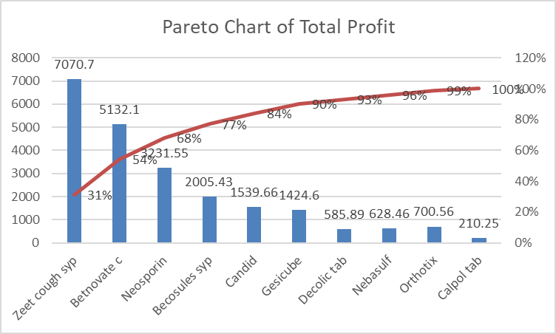
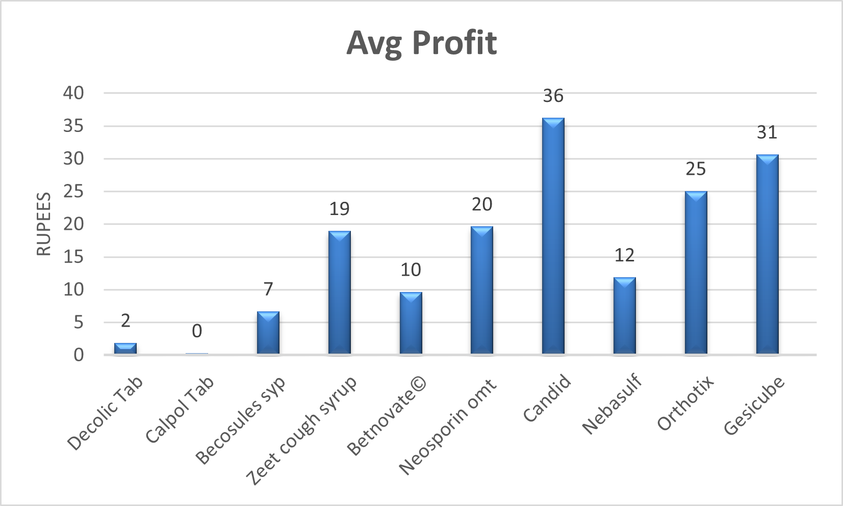
RESULTS
02.Profit/Loss
Highlight key insights from high-profit SKUs like
Candid Powder and Gesicube Oil, informing
strategic promotional efforts to optimize
profitability and adapt to market dynamics effectively.
Detailed profit analysis reveals high revenue correlates with high profitability, emphasizing revenue's pivotal role. Pareto chart shows 80% of total profit attributed to key SKUs like Zeet Cough Syrup, underscoring syrup category's profitability.

Slide 8
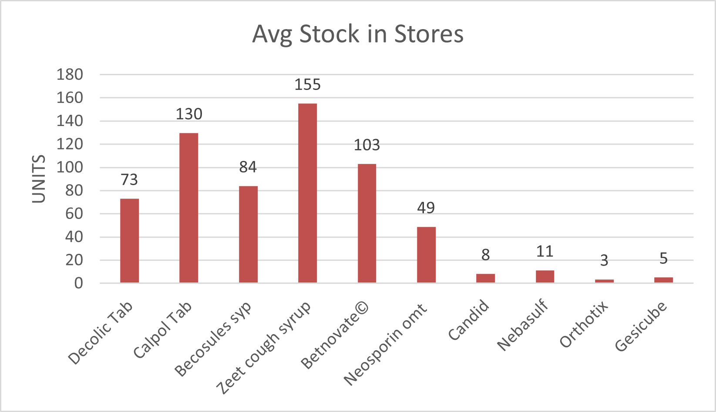
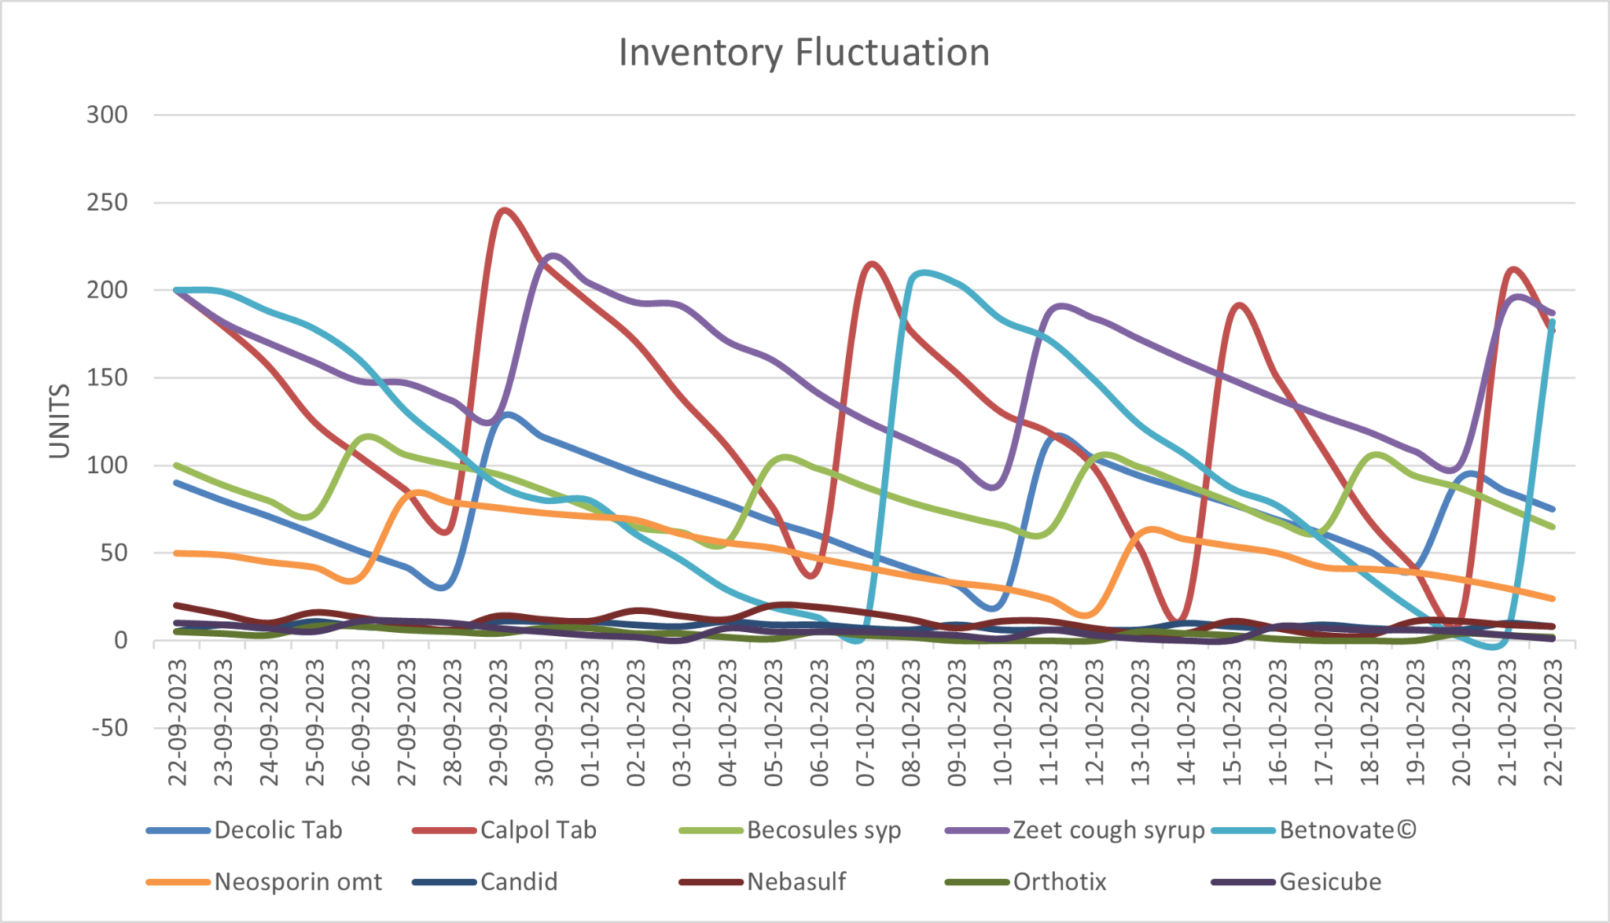
RESULTS
03.Inventory
Analysis reveals prudent stock management, aligning inventory levels with sales
performance efficiently. Observation on Zeet Cough Syrup suggests optimizing
stock quantities to enhance profitability.
Nuanced inventory fluctuation analysis depicts dynamic
response to sales trends. Synchronization between sales and
inventory highlights effective stock management strategy.
Overall, dynamic stock management strategy enhances
operational efficiency and profitability.

Slide 9
RECOMMENDATIONS
1. Increase Sales of High-Profit Items: Implement competitive pricing for Candid Powder and enhance promotion of Gesicube Oil through healthcare collaborations to maximize market competitiveness and capitalize on demand for joint pain relief.
2. Focus on High-Selling Items and Increase Sales: Introduce complementary products alongside high-demand items like Zeet Cough Syrup and enhance awareness of specific products like Becosules Syrup and Betnovate C Cream through targeted marketing to maximize cross-selling and sales.
3. Strategic Inventory Management: Strategically adjust stock levels of Zeet Cough Syrup based on sales patterns to optimize inventory turnover, reduce holding costs, and enhance profit margins.
4. Additional Revenue-Increasing Steps: Leverage healthcare professional partnerships to endorse high-margin products like Gesicube Oil for joint pain, expand offerings with premium variants, and promote prescription recommendations, enhancing visibility and trust for increased sales and revenue.

Slide 10
I extend my heartfelt gratitude to Dr. Ashwin and
Dr. Aaditya for their invaluable guidance and support
throughout the BDM Capstone Project.

